Slide 1
Predicting Power Efficiency using Advanced Regression Analysis.
By Yudhishtar Charan

Slide 2
Data Overview
Feature Name | Description
Feature_1,Feature_2,Feature_4,Feature_5,Feature_6,Feature_8,Feature_9, Feature_10, Feature_12, Feature_13,Feature_14, Feature_15 | Numerical feature (mean ~0, std ~1 with some outliers present)
Feature_3, Feature_7, Feature_11 | Numerical feature with missing values (10%) , Numerical feature (mean ~0, std ~1)
Device_Type | Categorical feature with 4 categories: Sensor, Actuator, Controller, Gateway
Environment | Categorical feature with 4 categories: Indoor, Outdoor, Industrial, Residential
Power_Efficiency | Continuous numerical target (mean ~103.12, std ~177.86, range approx. -611.05 to 792.30)

Slide 3
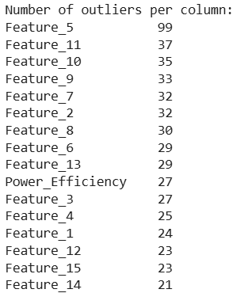
Data cleaning and formatting
No duplicates found
We have imputed nan values with median.
Removing Outliers using IQR method is dropping ~16% data and Z-score clipping ~5% data so we will use Z-score.

Slide 4
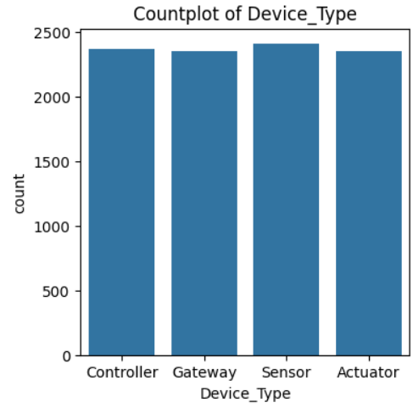
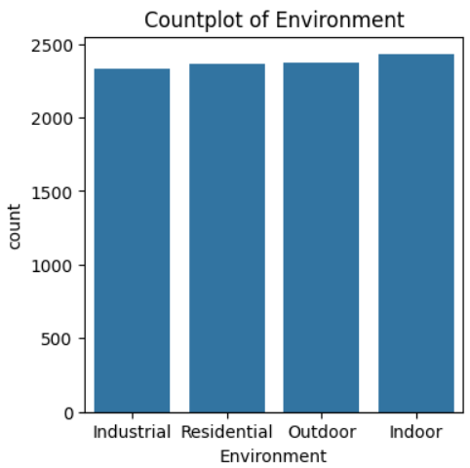
Univariate analysis for Object Data type

Slide 5
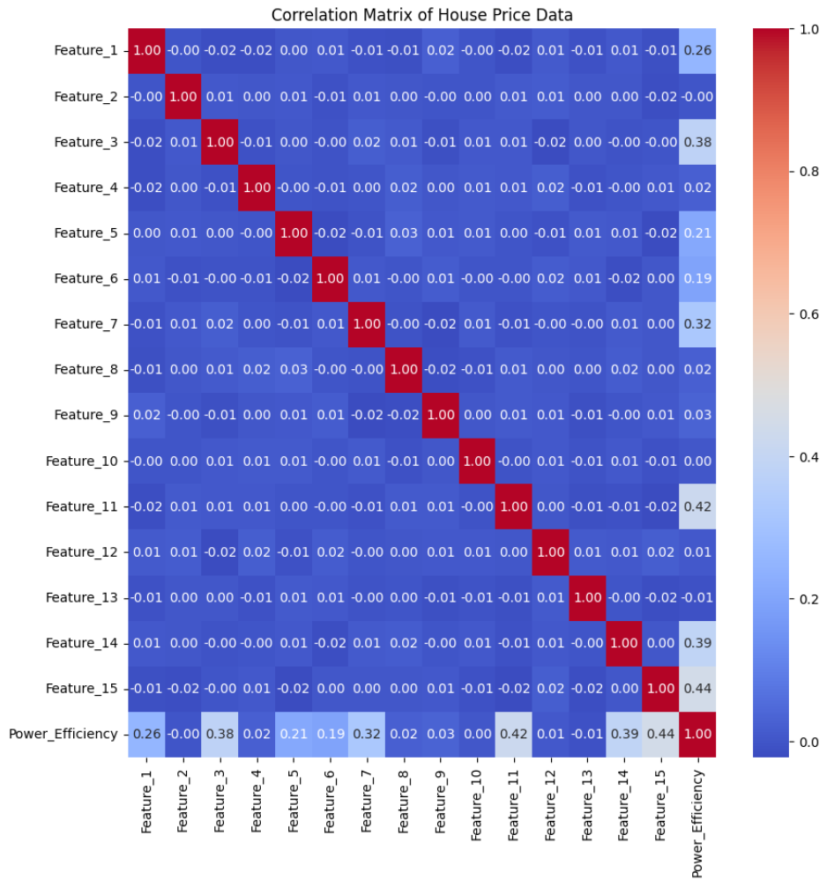
Bivariate analysis
All numerical features are relatively independent further hinting at PCA or similar technique being used. No correlation found between different features
Power_Efficiency is correlated to features 14,15,11,7 and 3 (with some weak correlation with 1,5,6)

Slide 6
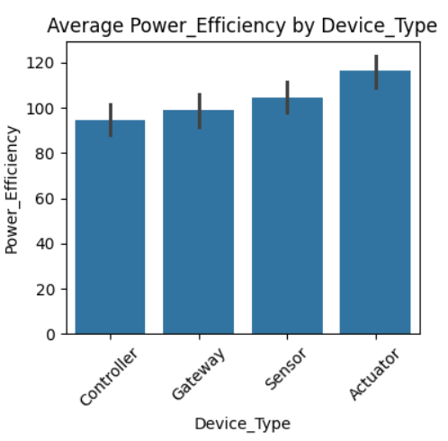
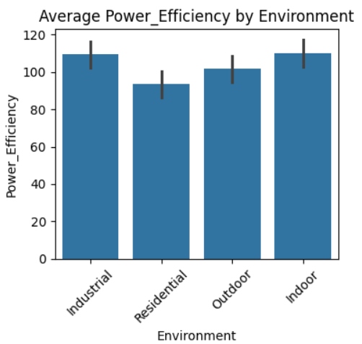
Power_Efficiency by device type and Environment
In 'device type' 'actuators' have max. avg. Power_efficency while in 'environment' 'industrial' and 'indoor' have max. avg. Power_efficency

Slide 7
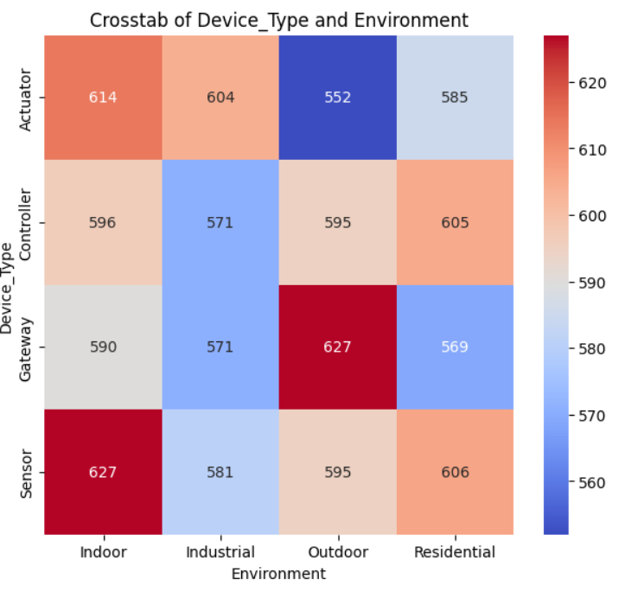
Device type and Environment
Crosstab values of both object object dtypes have ~600 in each segment so no trend seen.

Slide 8
Statistical analysis of features impact on Target
Device type does have difference in Power_Efficency (p value = 0.001) .however it doesn’t mean it contributes to the target’s variance significantly.
Environment category does have difference in Power_Efficency ( p value = 0.003) however it doesn’t mean it contributes to the target’s variance significantly.
Using mutual information score, correlation and Variance inflation factor we have arrived at these features for model training = ['Feature_1', 'Feature_3', 'Feature_5', 'Feature_6', 'Feature_7','Feature_11', 'Feature_14', 'Feature_15']

Slide 9
Model trained and metrics
Model Name | R2 Score (Test and Train) | Mean Squared Error | Hyperparameters
Linear Regression | (0.94 and 0.94) | 1835.6
Lasso Regression | (0.95 and 0.94) | 1692.2 | 'alpha': 0.01
Ridge Regression | (0.95 and 0.94) | 1692.2 | 'alpha': 1.0
KNN Regression | (0.86 and 0.85) | 4000.8 | 'n_neighbors': 13
Decision Tree | Below cutoff (0.62)* | - | -
Random Forest | Below cutoff (0.82)*
XGBRegressor | 0.92 | 2228.5 | 'learning_rate': 0.1, 'max_depth': 3, 'n_estimators': 200
Gradient Boosting | 0.92 | 2196.0 | 'subsample': 0.9, 'n_estimators': 200, 'min_samples_split': 10, 'min_samples_leaf': 2, 'max_depth': 3, 'learning_rate': 0.1

Slide 10
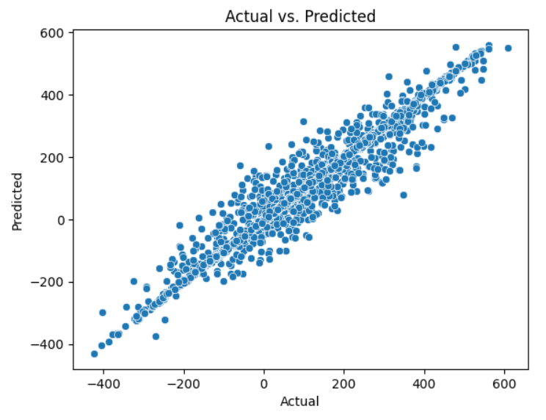
Best Model Selection
We have chosen L2 over L1 (Ridge over Lasso) for the following reasons:
All features left in the model after feature selection are useful but we want to reduce overfitting while ensuring robustness and stability.
Actual vs Predicted curve

Slide 11
Thank You

